Slide 1
TEACHING PUBLIC SERVICE-ORIENTED DATA SCIENCE
Andrew Heiss, PhD
Georgia State University
October 18, 2019
@andrewheiss
andhs.co/naspaa

Slide 2
DATA, DATA SCIENCE, & PUBLIC SERVICE

Slide 3

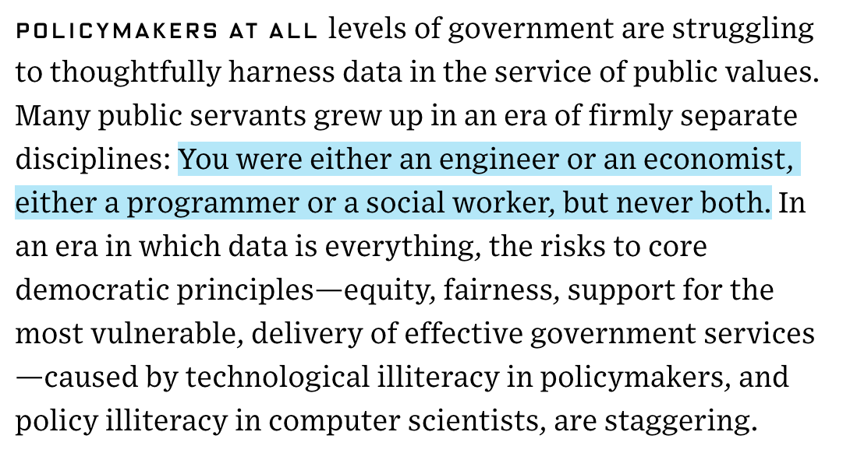
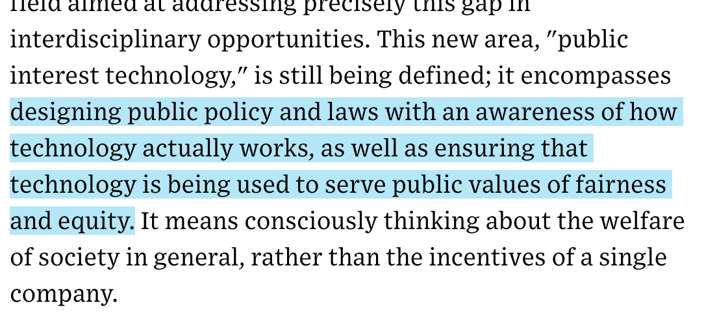
Notes:
https://www.wired.com/story/universities-public-interest-technology-courses-programs/

Slide 4



DATA AND GOVERNMENT
“To responsibly unleash the power of data to benefit all Americans”

Slide 5


Slide 6
WHAT IS “DATA SCIENCE”?
Big data
Algorithms
Machine learning
Data mining
Cloud computing
Neural networks
Artificial intelligence
PR-speak for “statistics”

Slide 7
WHAT IS “DATA SCIENCE”?
Turning raw data into understanding, insight, and knowledge
The process of creating insights using data

Slide 8
THE ETHOS OF SHARING

Slide 9
“Technology is neither radical nor revolutionary unless it benefits every single person”
DJ Patil, forum at Brigham Young University, February 13, 2018

Slide 10



Slide 11
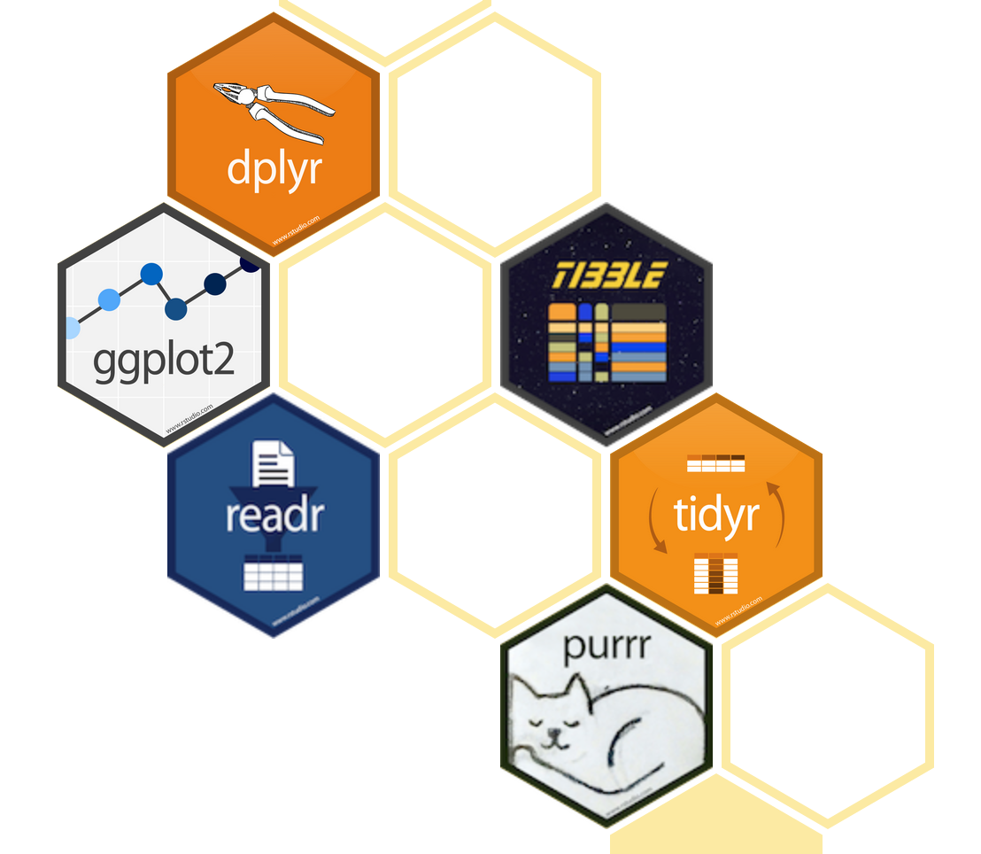



Slide 12
strike_damages_month <- bird_strikes %>%
group_by(Month) %>%
summarize(total_damages = sum(Cost, na.rm = TRUE),
average_damages = mean(Cost, na.rm = TRUE))
ggplot(data = strike_damages_month,
mapping = aes(x = Month, y = total_damages)) +
geom_col() +
scale_y_continuous(labels = dollar) +
labs(x = "Month",
y = "Total damages",
title = "Really expensive collisions happen in the fall?",
subtitle = "Don't fly in August or October?",
source = "Source: FAA Wildlife Strike Database")

Slide 13

ds4ps.org

Slide 14


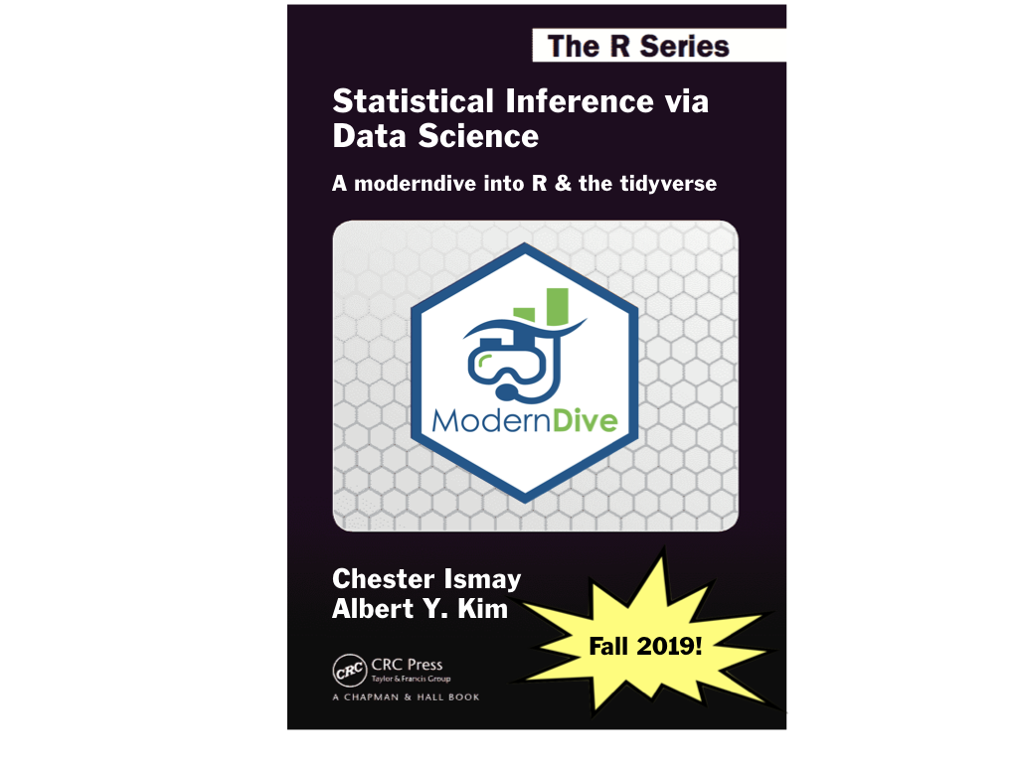
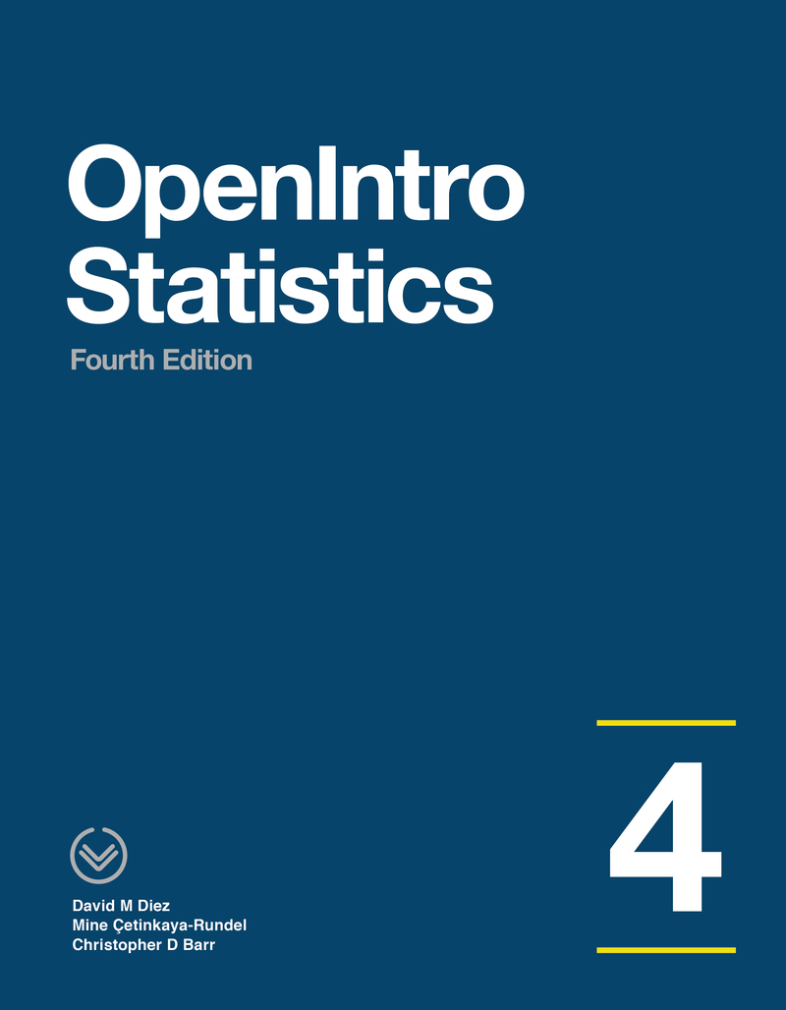


Slide 15

